Slide 1

Lesson 3.4: Customization II
Microsoft Philanthropies TEALS Program
Introduction to Computer Science
Semester 1

Slide 2
Customization II
After this lesson, you will be able to...
Build custom reporter and predicate blocks in SNAP

Slide 3
Today’s Plan
Do Now
Lesson
Lab: If My Calculations Are Correct
Debrief and wrap-up
Notes:
Duration Description
5 minutes | Welcome, attendance, bell work, announcements
10 minutes | Lesson
25 minutes | Lab: If My Calculations Are Correct
15 minutes | Debrief and wrap-up

Slide 4

Do Now 3.4: Practice Using Arguments
We can add an argument to the "gravity“ custom block from Do Now 3.3 and pass a rate we want the sprite to move. Then our jumping dog would not always fall at the same rate!
Add an argument named "rate" to the "gravity" block by clicking the "+" next to the custom block name.
Change the "move" block to move "rate" spaces by dragging the rate variable to the "move" block.
Notes:
Yesterday you created a "gravity" custom block where a sprite would fall to the ground and stop when it touched a color.
However, the sprite always falls at the same rate. How would we get the sprite to fall at different rates?
We will solve this problem by adding an argument to the custom block named "gravity". We can then pass the rate we want the sprite to move.
Open Do Now 3.3 with the "gravity" custom block.
Add an argument named "rate" to the "gravity" block by clicking the "+" next to the custom block name.
Change the "move" block to move "rate" spaces by dragging the rate variable to the "move" block.
You can now pass different rates in your "gravity" custom block call located in the sprite's forever loop.

Slide 5

Introducing the Reporter Block
In SNAP, a reporter block is used to report a value, which is usually used as an input to another block
Notes:
Ask students to find blocks with the reporter shape (round) and speculate as to what they do and point out familiar examples
Explain the concept of reporting (returning) a value, and how reporter blocks are used to provide values to commands
Emphasize that reporters do not (and should not) perform any action—they are used to compute values which are in turn used by commands

Slide 6
Introducing the Predicate Block
In SNAP, a predicate block is a special reporter block that must return true or false.
Notes:
Emphasize that predicates must return true or false
Be aware, but don't necessarily tell students, that SNAP does not enforce this
Ask students why it might be useful to differentiate predicates from other reporters
Only predicates can be used in a conditional

Slide 7



Lab 3.4: The Technicolor Window – Reporter Blocks
2 reporter blocks:
Write a custom SNAP reporter block called "min"
should report 2
Write a custom SNAP reporter block called "max"
should report 4
If the two numbers are equal, report either one.
Notes:
Image credit: Jay Sebastian

Slide 8



Lab 3.4: The Technicolor Window – Predicate Blocks
1 predicate block:
Write a custom SNAP predicate block called "between“
If the first number is equal to either of the other two numbers or is between them, the block should report true.

Slide 9


Lab 3.4: The Technicolor Window – Advanced Block
1 advanced custom block:
Write a custom SNAP reporter block called "distance to" that computes and reports the distance from a sprite's position to another point.
Use the "x position" and "y position" blocks to determine the sprite's position.
Distance formula: the distance between (x1, y1) and (x2, y2) is
sqrt((y2-y1)^2+(x2-x1)^2).
Notes:
Go over the distance formula using the example. sqrt((4-1)^2 + (4-0)^2) = sqrt(3^2 + 4^2) = sqrt(9 + 16) = sqrt(25) = 5
SNAP does not have a “square” block. Instead, students will need to multiply a number by itself to square it. If time permits, challenge the students to create a “square” operation custom block.

Slide 10

Lab 3.4: The Technicolor Window – Advanced Block
(4, 4)
c
b
Pythagorean equation
https://en.wikipedia.org/wiki/Pythagorean_theorem
(1, 0)
a
Notes:
Go over the distance formula using the example. sqrt((4-1)^2 + (4-0)^2) = sqrt(3^2 + 4^2) = sqrt(9 + 16) = sqrt(25) = 5
SNAP does not have a “square” block. Instead, students will need to multiply a number by itself to square it. If time permits, challenge the students to create a “square” operation custom block.

Slide 11


Lab 3.4: The Technicolor Window – Advanced Block
1 advanced custom block:
Write a custom SNAP reporter block called “snap to range” which takes a number and a range consisting of two other numbers (three arguments total). If the first argument is within the range, it simply reports the same number; otherwise, it reports the number in the range which is closest to the first argument.
Hint: think about how you can use the blocks from part 1
Notes:
Go over the distance formula using the example. sqrt((4-1)^2 + (4-0)^2) = sqrt(3^2 + 4^2) = sqrt(9 + 16) = sqrt(25) = 5
SNAP does not have a “square” block. Instead, students will need to multiply a number by itself to square it. If time permits, challenge the students to create a “square” operation custom block.

Slide 12
Lab 3.4: The Technicolor Window – Advanced Block
5 ranges (R1-5) to evaluate (and test):
R1 => lower
R2 => n
R3 => n
R4 => n
R5 => upper
R3
R2
R3
R1
R5
n (3)
lower (5)
upper (10)
Notes:
Go over the distance formula using the example. sqrt((4-1)^2 + (4-0)^2) = sqrt(3^2 + 4^2) = sqrt(9 + 16) = sqrt(25) = 5
SNAP does not have a “square” block. Instead, students will need to multiply a number by itself to square it. If time permits, challenge the students to create a “square” operation custom block.

Slide 13

Lab 3.4: The Technicolor Window – Building on our Work
1 advanced custom block:
Create a custom SNAP block called “go randomly outside square” which will teleport a sprite to a random location OUTSIDE of the square’s area.
Hint: it may help to think of this in reverse --how can we tell if the sprite is insidethe square, using our custom blocks? How can we keep teleporting to random points on the stage until we know that we are notinside the square?
Hint: think about how you can use the blocks from previous steps.
Notes:
Go over the distance formula using the example. sqrt((4-1)^2 + (4-0)^2) = sqrt(3^2 + 4^2) = sqrt(9 + 16) = sqrt(25) = 5
SNAP does not have a “square” block. Instead, students will need to multiply a number by itself to square it. If time permits, challenge the students to create a “square” operation custom block.

Slide 14
Lab 3.4: The Technicolor Window – Building on our Work
Pseudocode:
Given the half length of the side of a square centered at 0,0
Get a random X and Y for the sprite location
If X, Y is inside the square? Then go to 2. Else go to 3.
Move sprite to X, Y
Y
(50, 50)
(X, Y)
X
(X, Y)
Notes:
Go over the distance formula using the example. sqrt((4-1)^2 + (4-0)^2) = sqrt(3^2 + 4^2) = sqrt(9 + 16) = sqrt(25) = 5
SNAP does not have a “square” block. Instead, students will need to multiply a number by itself to square it. If time permits, challenge the students to create a “square” operation custom block.

Slide 15

Lab 3.4: The Technicolor Window – Building on our Work
Then, add an argument to the block to use in place of “50” -- in technical terms, this argument is half the length of a side of the square. Hint: for a given number “num”, you can use (0 - num) or (-1 x num) to compute its negative. Hey, maybe you should make a “negative of” custom block!
Example: this will teleport the sprite to a random position on the stage which is not inside the square with corners at (-30, 30), (30, 30), (30, -30), and (-30, -30).
Notes:
Go over the distance formula using the example. sqrt((4-1)^2 + (4-0)^2) = sqrt(3^2 + 4^2) = sqrt(9 + 16) = sqrt(25) = 5
SNAP does not have a “square” block. Instead, students will need to multiply a number by itself to square it. If time permits, challenge the students to create a “square” operation custom block.

Slide 16

Lab 3.4: The Technicolor Window – Building on our Work
1 advanced custom block:
Create a custom SNAP block called “go to square” that takes the same argument as before (i.e. half-side length of a square centered at the stage origin); this block should make the sprite go to the nearest point on the square. If the sprite is already inside the square’s area, then it does nothing. Hint: writing this block is simple if we use the “snap to range” custom block.
Notes:
Go over the distance formula using the example. sqrt((4-1)^2 + (4-0)^2) = sqrt(3^2 + 4^2) = sqrt(9 + 16) = sqrt(25) = 5
SNAP does not have a “square” block. Instead, students will need to multiply a number by itself to square it. If time permits, challenge the students to create a “square” operation custom block.

Slide 17
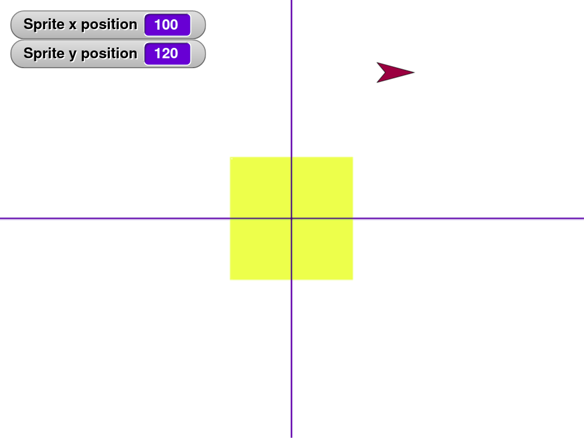
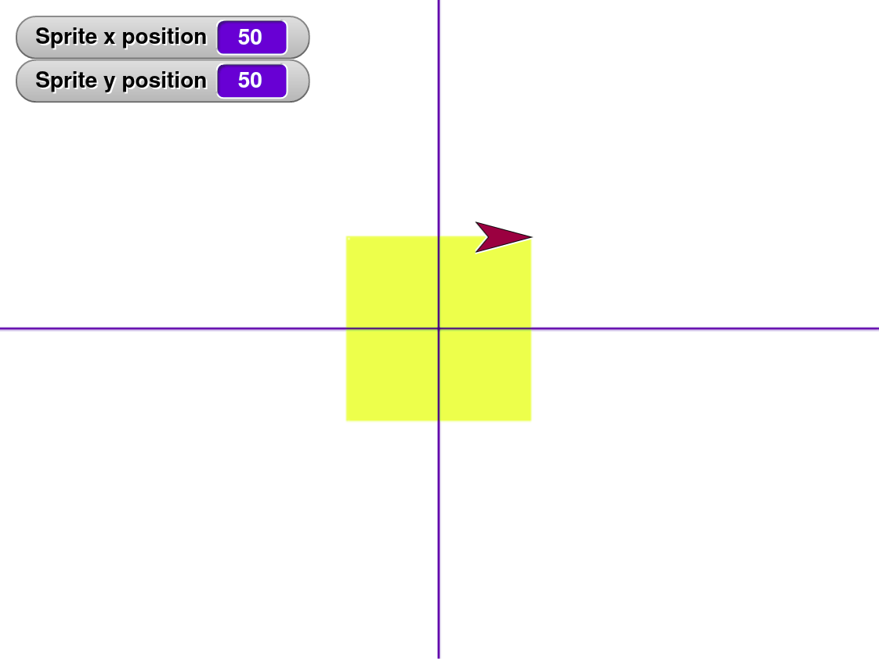
Lab 3.4: The Technicolor Window – Building on our Work
Notes:
Go over the distance formula using the example. sqrt((4-1)^2 + (4-0)^2) = sqrt(3^2 + 4^2) = sqrt(9 + 16) = sqrt(25) = 5
SNAP does not have a “square” block. Instead, students will need to multiply a number by itself to square it. If time permits, challenge the students to create a “square” operation custom block.

Slide 18
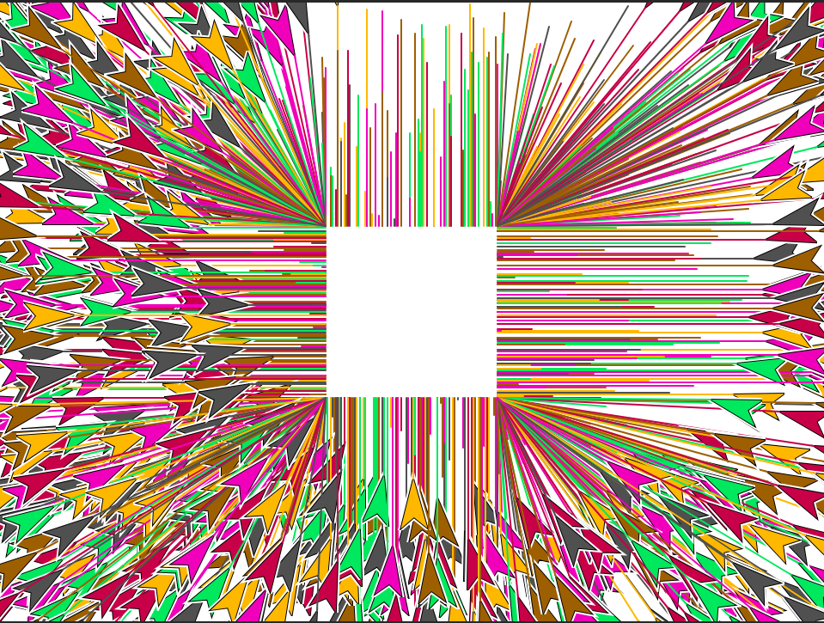
Lab 3.4: The Technicolor Window – Putting it all Together
Follow the steps described in the Lab handout to create drawings
Notes:
Go over the distance formula using the example. sqrt((4-1)^2 + (4-0)^2) = sqrt(3^2 + 4^2) = sqrt(9 + 16) = sqrt(25) = 5
SNAP does not have a “square” block. Instead, students will need to multiply a number by itself to square it. If time permits, challenge the students to create a “square” operation custom block.

Slide 19

Debrief
Let’s share some of your solutions!
min/max blocks
between block
distance to block
Can you think of examples of when these blocks may be useful?
Notes:
Ask a different student to provide their solution to each part. If time permits, go over multiple students' work for each part.
Point out differences and discuss advantages and disadvantages to different approaches.
Emphasize that custom blocks do not have to be long and complicated to be useful.

Slide 20

Exit Ticket
In your notebook answer the following,
What is a reporter block?
What is a predicate block?
Discussion: Share what you were having trouble with.

